Slide 1
CHAPTER 6: UNDERSTAND CONSUMER AND BUSINESS MARKETS
Copyright © McGraw-Hill Education. All rights reserved. No reproduction or distribution without the prior written consent of McGraw-Hill Education.
McGraw-Hill Education
Part 2: Use Information to Drive Marketing Decisions

Slide 2
Learning Objectives
Understand the value of knowing the consumer.
Consider the role of personal and psychological factors in consumer decision making.
Appreciate the critical and complex role of cultural, situational, and social factors in a consumer purchase decision.
Understand the consumer decision making process.
Understand the differences between B2C and B2B markets.
Understand the critical role of the buying center and each participant in the B2B process.
Learn the B2B purchase decision process and different buying situations.
Comprehend the role of technology in business markets.

Slide 3
The Power of the Consumer
Marketers are interested in learning about the process people use to make purchase decisions.
A company can only deliver value with an accurate and timely understanding of the customer.
Complex forces influence consumer choices and these forces change over time.

Slide 4
Model of the Consumer Decision Process
Exhibit 6.1
Link to long alt text description

Slide 5
Personal Characteristics
Life Cycle Stage (Age) | Occupation
Lifestyle | Gender Roles
Notes:
Marketers realize that changes in life stage (for example, graduating from college, getting married, or having a child) transform an individual’s buying habits and are referred to as the family life cycle. FLC is often more important that age. New parents need to care for baby, no matter how old they are.
People are influenced by their work environment. From the executive suite to the plant floor, people who work together tend to buy and wear similar clothes, shop at the same stores, and vacation at the same places.
Lifestyle references an individual’s perspective on life and manifests itself in that person’s activities, interests, and opinions (AIO).
In general, women have been adding new roles as they move into the workforce and positions of political power. In the United States, this means that men and women are more likely to share responsibilities than live in a traditional household where the men work and women stay at home to raise the children.

Slide 6
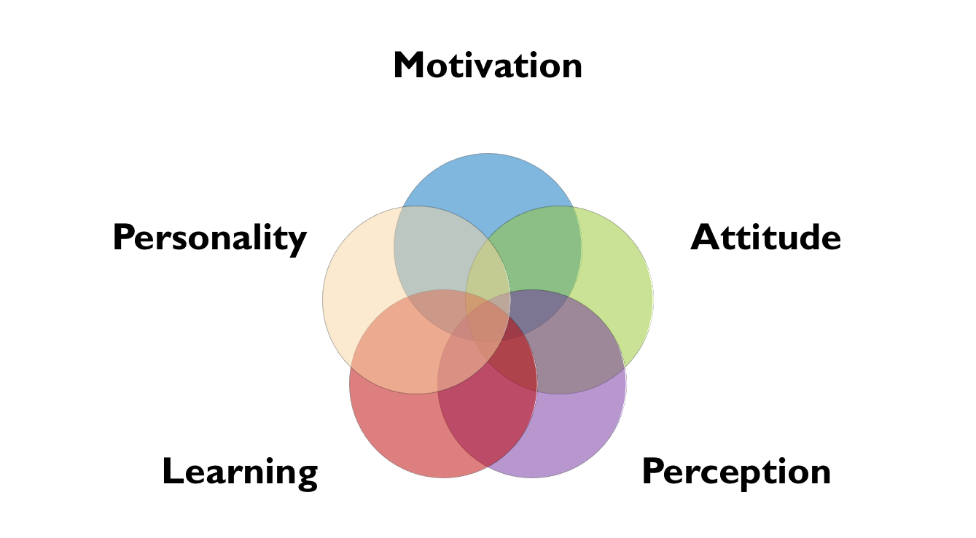
Psychological Attributes

Slide 7
Motivation and Attitude
Motivation: The stimulating power that induces and then directs behavior.
Attitude: A learned disposition to respond to an object or class of objects in a consistently favorable or unfavorable way.

Slide 8
Contemporary Theories of Motivation
Exhibit 6.3
 | Theory | Key Elements | Marketing Implications
Maslow’s Hierarchy of Needs Theory | Humans have wants and needs which influence their behavior. People advance only to the next level if the lower needs are meet. | Physiological Safety Love/Social Self Esteem Self Actualization | Individuals are not interested in luxuries until they have had basic needs (food, shelter) met
Herzberg’s Two Factor Theory | Certain factors in the workplace result in job satisfaction. | Motivators: challenging work, recognition, and responsibility Hygiene factors: status, job security, salary, and benefits | Satisfying hygiene factors does not create a loyal employee or customer. For a company to really create really satisfied employees it is important to focus on motivators
Aldelfer’s ERG Theory | Expansion on Maslow’s Hierarchy placing needs in three categories. | Existence Relatedness Growth | People need a sense of belonging and social interaction. Creating a relationship with the customers extends the customers satisfaction with the product
McClelland’s Achievement Motivation Theory | There are three categories of needs and people differ in the degree in which the various needs influence their behavior | Need for Achievement Need for Power Need For Affiliation | Companies can be successful targeting one of three basic needs.

Slide 9
Perception
Perception is a system to select, organize, and interpret information to create a useful, informed picture of the world.
Selective Awareness | Selective Distortion | Selective Retention
Implies focusing on what is relevant | Implies information can be misunderstood or made to fit existing beliefs | Implies storing in memory stimuli that support existing beliefs and attitudes
Notes:
In marketing, perception of a product is even more important than the reality of that product because, in a very real sense, an individual’s perception is his or her reality. Perception drives attitudes, beliefs, motivation, and, eventually, behavior. Since each individual’s perception is unique, everyone’s perceptual response to the same reality will vary.
Selective awareness: An individual is exposed, on average, to between 2,000 and 3,000 messages daily. People cannot process, let alone retain, all those messages, so they employ a psychological tool known as selective awareness to help them focus on what is relevant and eliminate what is not. The challenge for marketers is breaking through people’s decision rules, which are designed to reject the vast majority of stimuli they see every day.
Even if a stimulus is noticed, there is no guarantee it will be interpreted accurately. Information can be misunderstood or made to fit existing beliefs, a process known as selective distortion.
Selective retention is the process of placing in one’s memory only those stimuli that support existing beliefs and attitudes about a product or brand. This is significant because memory is where people store all past learning events; in essence it is the “bank” where people keep their knowledge, attitudes, feelings, and beliefs.

Slide 10
Learning
Learning: Any change in the content or organization of long-term memory or behavior.
Conditioning creates an association between two stimuli.
Classical conditioning promotes learning through stimulus and response.
Operant conditioning rewards desirable behavior.
Cognitive learning is more active and requires information to work through problems and life situations.
Notes:
Learning is any change in the content or organization of long-term memory or behavior. Learning occurs when information is processed and added to long-term memory. Marketers can therefore affect learning by providing information using a message, format, and delivery that will encourage customers to retain the information in memory.
Classical conditioning seeks to have people learn by associating a stimulus (marketing information, brand experience) and response (attitude, feeling, behavior).
Many companies today use a variety of music genres in their ads, designed to connect with specific target audiences. Ads for products targeted at young people use current artists, while older target markets like Baby Boomers respond to music from the 1960s and 1970s. This is conditioned learning, by connecting the stimulus--music--with a response--a positive association with a particular brand.
The other type of conditioning, operant conditioning, entails rewarding a desirable behavior, for example, a product trial or purchase, with a positive outcome that reinforces that behavior. For example, many different types of food retailers offer product samples in their stores. Frito-Lay, for instance, offers free in-store samples of Doritos for the express purpose of getting people to try the product, enjoy the product, and finally purchase a bag of Doritos. Enjoying the Doritos reinforces the positive attributes of the product and increases the probability of a purchase. Since the consumer must choose to try the product for operant conditioning to occur, Frito-Lay wants to make the trial as easy as possible.

Slide 11
Personality
Each person has a set of consistent, enduring personal characteristics.
Those characteristics can be measured to identify differences between individuals.
Notes:
Most believe personality characteristics are formed at a relatively early age and can be defined in terms of traits such as extroversion, instability, agreeableness, openness to new experiences, and conscientiousness. These core traits then lead to outward characteristics, which are what people notice.

Slide 12
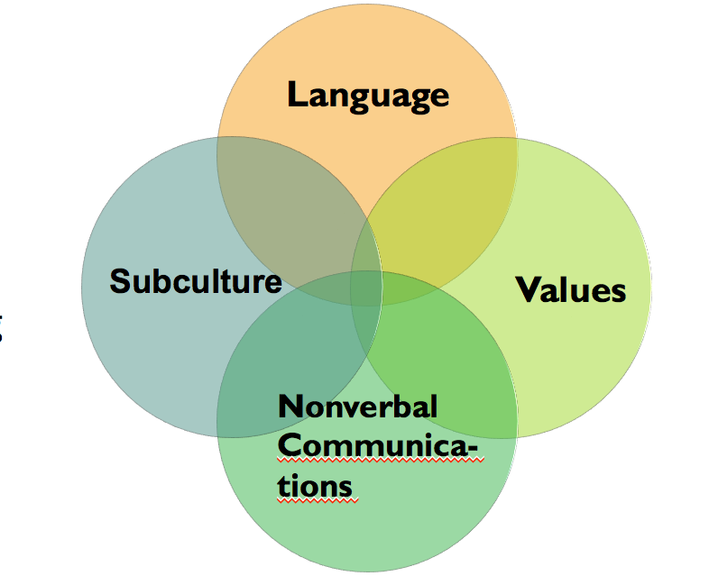
External Factors Shape Consumer Choices: Cultural
Culture is a system of values, beliefs, and morals shared by a particular group of people that permeate over time.
Learning a target market’s culture is essential to creating an effective marketing strategy. Not understanding a culture may mean poor market acceptance of a product.
Notes:
Language is an essential cultural building block and the primary communication tool in society. At the most basic level it is important to understand the language, making sure that words are understood correctly. However, language conveys much more about a society and its values. Scandinavian cultures, for example, place a high value on spending time together. They have more words to express “being together” than English does, and their meaning implies a more intimate sharing of thoughts and ideas.
Cultural values are principles shared by a society that assert positive ideals. These principles are often viewed on a continuum.
A subculture is a group within the culture that shares similar cultural artifacts created by differences in ethnicity, religion, race, or geography. While part of the larger culture, subcultures are also different from each other. The United States is perhaps the best example of a country with a strong national culture that also has a number of distinct subcultures
Nonverbal communication is the means of communicating through facial expressions, eye behavior, gestures, posture, and any other body language.

Slide 13
External Factors Shape Consumer Choices: Situational
Situational factors
Physical surroundings
Personal circumstances
Time
Notes:
People are profoundly affected by their physical surroundings. Retailers devote a lot of time and resources to creating the right physical surrounding to maximize the customer’s shopping experience. They know people respond differently to changes in color, lighting, location of the product within the store; indeed, almost every element of the customer’s experience is considered important in the consumer choice process.
An individual’s behavior is always filtered through their immediate personal circumstances. Parents with crying children shop differently than parents with small kids enjoying the experience, and parents without the kids along shop differently than parents with their children present. While it is not possible for marketers to control personal circumstances, it is important to understand how personal situations influence the choice process. Consider cold medicine such as Tylenol Cold Relief. Johnson & Johnson, maker of Tylenol Cold medicine, knows that people frequently purchase the product when they are not feeling well. As a result, the company makes the product readily available using a wide distribution channel.
Time is a critical situational factor that affects individuals throughout the consumer choice process. An emerging consumer trend in many industrialized countries is the willingness to trade time for money.

Slide 14
External Factors Shape Consumer Choices: Social
Social Factors
Family
Household life cycle
Social class
Opinion leaders and market mavens
Reference groups
Notes:
The first group any individual belongs to is the family. Families are the single most important buying group and they influence the consumer choice process in two ways. First, the family unit is the most influential teacher of cultural values. Children are socialized into a community and its values primarily through the family unit as they interact with parents, siblings, and extended family members. Second, children learn consumer behavior from their parents. As adults and later parents, they model the behavior first learned as a child.
The household life cycle (HLC) is fundamental to understanding the role of family in the consumer choice process. The traditional family life cycle consists of a fairly structured set of activities that begins when single people get married (20s), start a family (30s), raise kids (40s to 50s), watch as the kids grow up and leave home (50s to 60s), and finally enter into retirement (60s and beyond). However, while this model is still relevant in many cases, several new models have emerged to reflect changes in the household life cycle. People are marrying later and putting off the start of a family. Women are having children later in life for a variety of reasons (marry later, focus on career). Couples raise kids then divorce and remarry, creating blended families, or they start new families of their own.
Social class is a ranking of individuals into harmonized groups based on demographic characteristics such as age, education, income, and occupation.
Most Western cultures have no formal social class system; however, there is an informal social ranking. These informal systems exert influence over an individual’s attitudes and behavior. Two factors drive social status. Success-driven factors have the greatest effect on social status and include education, income, and occupation. Innate factors, the second category, do not result from anything the individual has done but, rather, are characteristics the individual has inherited from birth. Social class is not the result of a single factor, such as income, but rather a complex interaction among many characteristics. While some social class drivers are not in the individual’s control, people do make choices about their education and occupation. Therefore, it is possible for people, particularly in societies providing educational opportunities, to move into new social classes based on their achievements. In addition, the availability of easy credit, creative pricing, and new financing arrangements enable and even encourage people to engage in aspirational purchases. Aspirational purchases are products bought outside the individual’s social standing.
People seek out opinion leaders for a variety of reasons, including unfamiliarity with a product, reassurance about a product selection before purchasing, and anxiety resulting from high involvement with the purchase of a particular product. Anyone whose opinions are valued by the individual can be an opinion leader. A new group, whose members are called market mavens, has information about many kinds of products, places to shop, and other facets of markets, and the members initiate discussions with consumers and respond to requests from consumers for market information.36 The key difference between opinion leaders and market mavens is the focus on their market knowledge. Market mavens have a broader understanding and expertise that goes beyond product to include other elements of the purchase decision such as shopping experience and price.
A reference group is group of individuals whose beliefs, attitudes, and behavior influence (positively or negatively) the beliefs, attitudes, and behavior of an individual. Three characteristics are used to categorize reference groups: association, desirability, and degree of affiliation.

Slide 15
The Level of Involvement Influences the Process
Involvement activated by:
A person’s background.
The aspirational focus.
Environment at decision-making time.
High-Involvement Learning:
People spend time more time in the decision-making process and report higher satisfaction.
Low-Involvement Learning:
Routine or relatively unimportant decision-making.
Notes:
Decision Making with High Involvement
Greater motivation that leads to greater involvement results in a more active and committed choice decision process. When someone is concerned with the outcome of the process, they will spend more time learning about product options and become more emotionally connected to the process and the decision. Someone stimulated to acquire new information is engaged in high-involvement learning. For example, someone interested in purchasing a new high-end digital camera will seek out product reviews on CNET.com or other online sources to discover information that will assist in the choice decision. Some, despite a brand preference, may be willing to experiment with other brands and seek out additional information looking for a new alternative. A high level of involvement usually means the entire process takes longer. High-involvement consumers report high levels of satisfaction in their purchase decision.
Low-involvement learning happens when people are not prompted to value new information. This is more prevalent than high-involvement learning because the vast majority of marketing stimuli occur when there is little or no interest in the information. People do not watch TV for the commercials; they watch for the programming, and advertising is just part of the viewing experience. Likewise, print advertising exists alongside articles and is often ignored. While people are not actively seeking the information, they are exposed to advertising and this, in turn, affects their attitudes about a brand. Research suggests that people shown ads in a low-involvement setting are more likely to include those brands in the choice decision process. Low-involvement consumers spend little time comparing product attributes and frequently identify very few differences across brands. Because the decision is relatively unimportant, they will often purchase the product with the best shelf position or lowest price with no evaluation of salient product characteristics

Slide 16
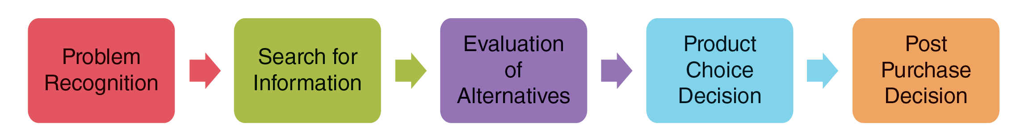
Consumer Decision-Making Process
Exhibit 4.10
Link to long alt text description

Slide 17
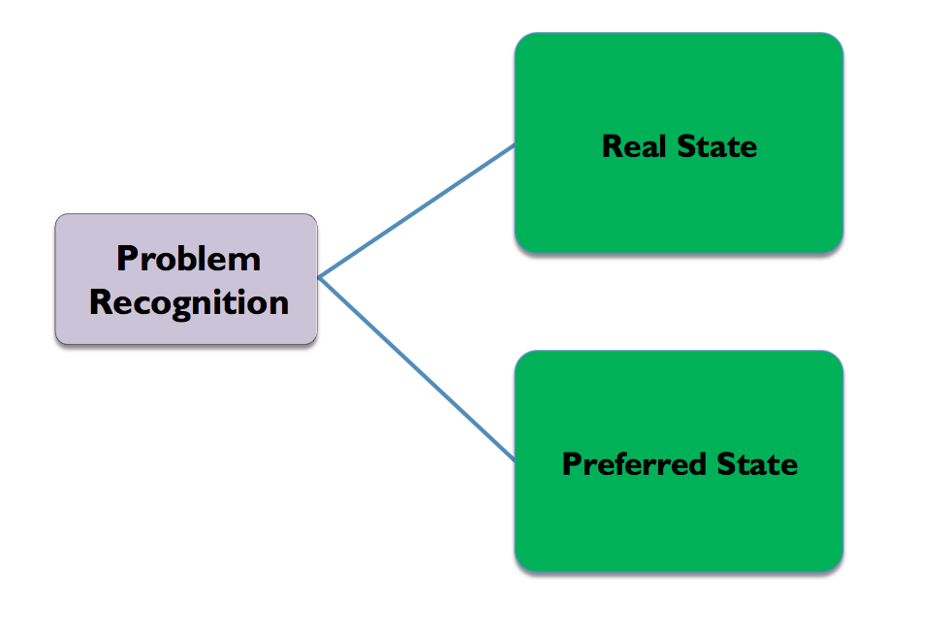
The Consumer Decision-Making Process: Problem Recognition
Notes:
People live in the perceived reality of present time or real state. At the same time, people also have desires that reflect how they would like to feel or live in the present time and this is known as a preferred state. When the two states are in balance, the individual does not require anything and no purchase occurs. However, where there is a discrepancy in the two states, a problem is created and the consumer decision-making process begins.
The discrepancy, or gap, can be created by internal or external drivers. Internal drivers are basic human needs such as hunger and security. Someone is hungry (real state) and wants to eat (preferred state). This will lead to a number of choices: eat at home, dine out, or go to the grocery store. It may even trigger other options such as calling a friend, which addresses a need for social interaction. External drivers happen as people interact with the world. Some of these triggers result from a company’s marketing efforts, but most arise when an individual experiences something that creates a desire, like seeing a friend driving a new car or hearing about a good new restaurant.

Slide 18
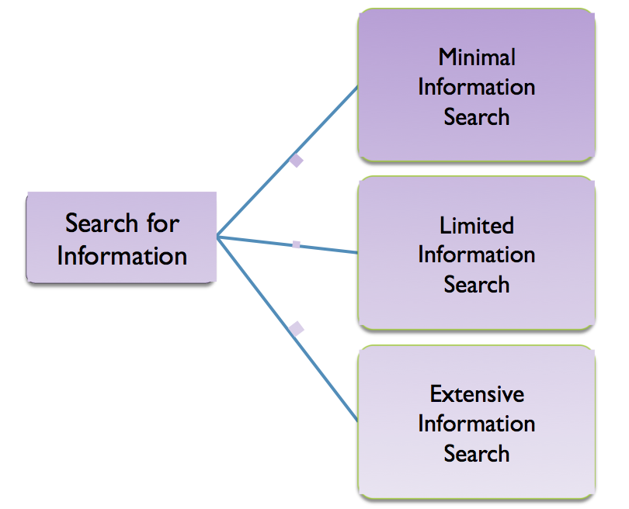
The Consumer Decision-Making Process: Search for Information
Link to long alt text description
Notes:
. A couple notices the low-fuel light comes on as they are driving home from a party. The driver recalls their “local” station is on the way home and, without any additional information, stops at the station and fills up the car. This is an example of minimal information search. The same couple now finds out they are going to have a baby and realizes their Mercedes-Benz C-class coupe has to be replaced with a more practical vehicle. They engage in a thorough information search reviewing car magazines, soliciting opinions from friends and family, conducting online research on sites like Edmunds or KBB, and test-driving a number of new cars and SUVs before making a final purchase decision. This is an example of extensive information search. Between these two extremes is limited information search, which, as the name implies, involves some, albeit restricted, search for information. Suppose the wife from the couple in our previous examples has a cold. The husband stops at the drugstore to get her some medicine. At the cold medicine aisle he scans the boxes looking for the one that will provide “maximum relief” for his wife’s symptoms. He may even ask the pharmacist for help in selecting the best choice. At this point he is engaged in a limited search for information. Generally, people do only the amount of information search they believe is necessary to make the best decision.

Slide 19
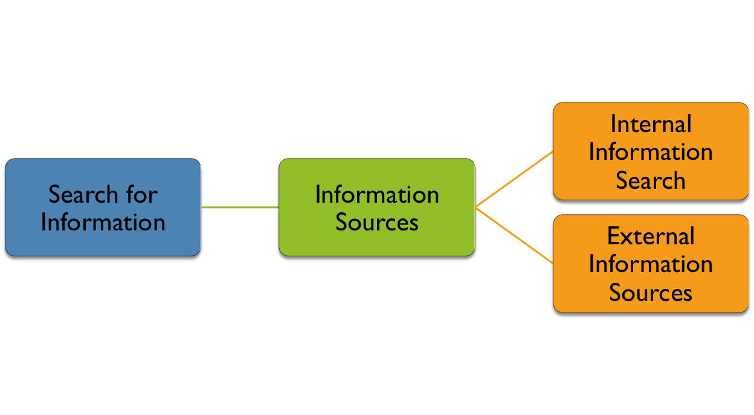
The Consumer Decision-Making Process: Information Sources
Link to long alt text description
Notes:
Internal information sources, as the name implies, are all information stored in memory and accessed by the individual. This is always the first place people consider for information. Past experiences, conversations, research, pre- existing beliefs, and attitudes create an extensive internal database that is tapped by the individual once the problem is recognized.
External information sources include independent groups (sources), personal associations (friends and family), marketer-created information (automobile manufacturer’s website advertising), and experiences (product trial and demonstrations).

Slide 20
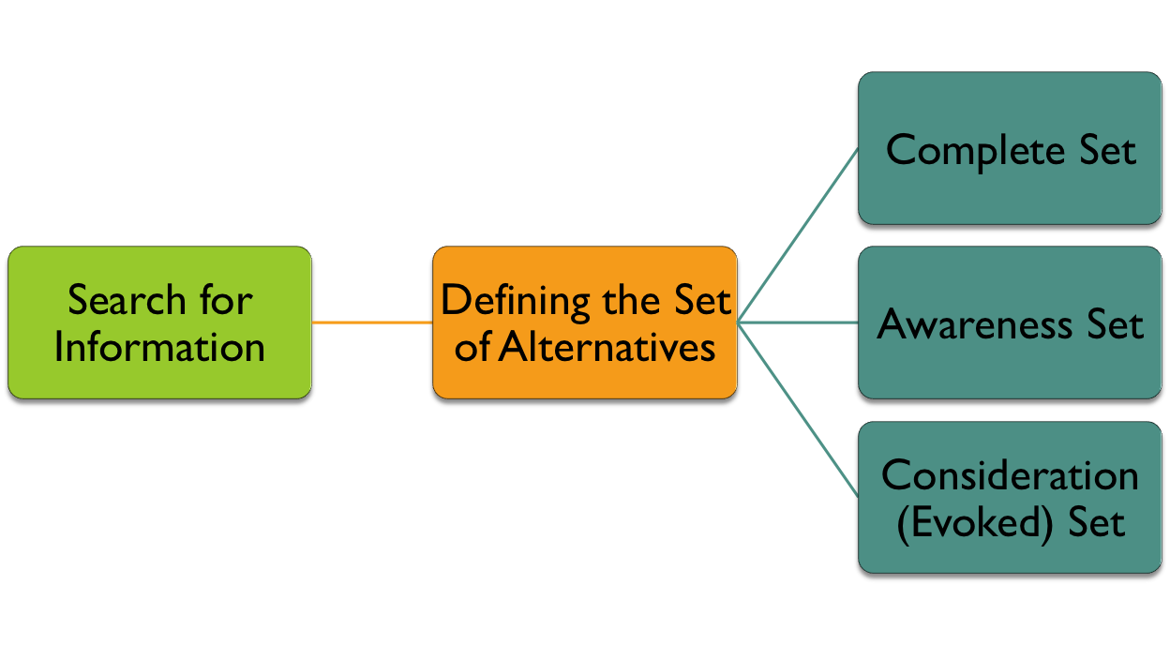
The Consumer Decision-Making Process: Set of Alternatives
Link to long alt text description
Notes:
People begin with a very large set of possible alternatives known as the complete set. This set includes a variety of options across different brands and perhaps even products. . The awareness set reduces the number of options. At a minimum, the number of different product categories, if considered, will be reduced and some brands discarded. Interestingly, the awareness set can include choices across product categories. In our example, it is still possible for a particular brand of cell phone to remain in the awareness set despite the fact they are different product categories. From the awareness set, individuals conduct an additional information search. Based on additional information and evaluation, a consideration (evoked) set is created, which encompasses the strongest options. It is from the consideration set that the product decision is made.

Slide 21
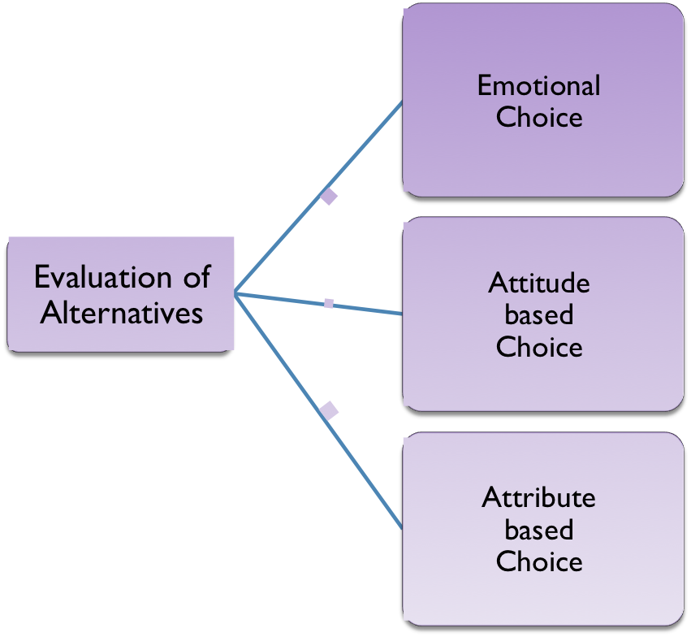
The Consumer Decision-Making Process: Evaluation of Alternatives
Link to long alt text description
Notes:
Not all purchases are made strictly for rational reasons. Indeed, product choices can be emotional choices, based on attitudes about a product, or based on attributes of the product depending on the situation. Frequently, the product choice encompasses a mix of all three. An individual enjoys yogurt and taking a break to enjoy a snack (emotional based). That same person considers Chobani Greek Yogurt the best choice for a healthy yogurt (attitude based). Finally, the individual considers Chobani Greek Yogurt to be better tasting than other competitors (attribute based).
Attitude-based choices tend to be more holistic, using summary impressions rather than specific attributes to evaluate the options and affect even important purchases such as a car or house. It is not uncommon for beliefs to affect the actual product decision. For example, “it is important to buy cars made in America” or the opposite, “foreign cars are better than American products.”

Slide 22
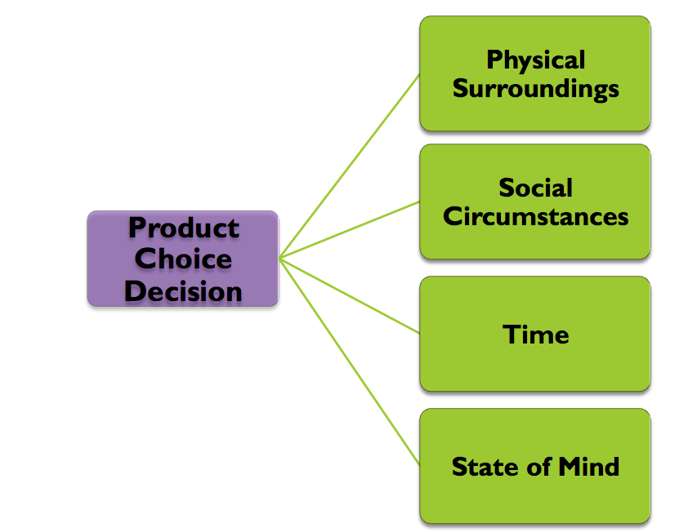
The Consumer Decision-Making Process: Product Choice Influences
Link to long alt text description
Notes:
Physical surroundings—the environment for the purchase. From store colors to the employees, consumers respond to their physical environment.
Shopping is a social activity and people are influenced by the social interaction at the time of purchase. Shopping alone or with a friend can influence the purchase decision.
Time pressure or the lack thereof will impact decision-making.
An individual’s mood influences the purchase decision. People in a positive state of mind are more likely to browse. Negative mood states are less tolerant and lead to increased impulse and compulsive purchases.

Slide 23
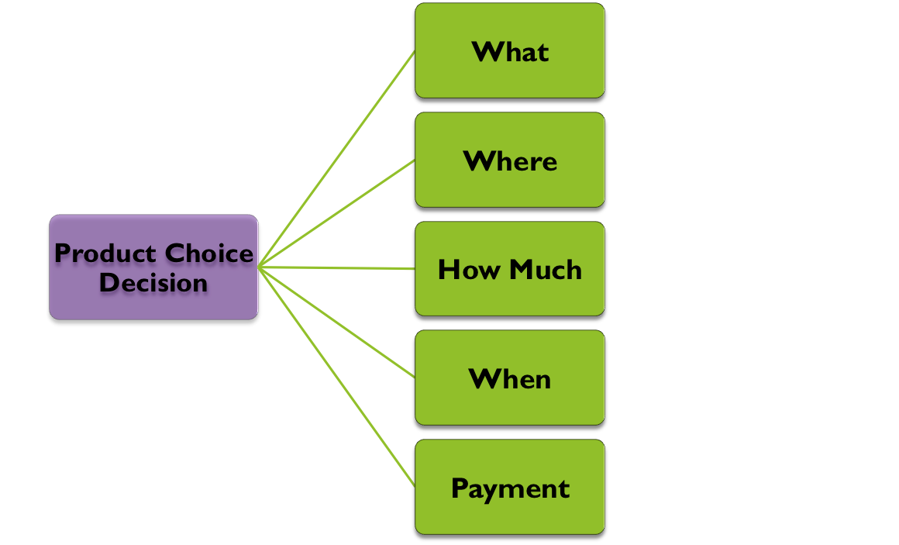
The Consumer Decision-Making Process: Product Choice Factors
Notes:
What: select the product and, more specifically, the brand. Included as part of the product choice are decisions about product features, service options, and other characteristics of the product experience.
Where: select the point of purchase. Select the retailer and, increasingly, the channel—retail store (bricks) or online (clicks)—through which the product is to be purchased.
How much: choose the specific quantity to be purchased. For example, warehouse clubs, such as Sam’s Club and Costco, offer consumer options on purchase quantity. If you have the ability to store products, it is possible to save money by purchasing in larger quantities.
When: select the timing of the purchase. The timing of the purchase can make a difference in the final purchase price. Car dealers traditional offer better deals at the end of the month as they try to meet monthly sales quotas. Through sales and other marketing communications, marketers encourage consumers to purchase sooner rather than later.
Payment: choose the method of payment. The selection of a payment method makes a big difference to the consumer and marketer. Marketers want to make it easy for the consumer to purchase; however, not all payment methods are equal. Credit cards charge the retailer a fee that, in turn, is passed back to the consumer. One payment method, the debit card, is becoming popular, combining the convenience of a credit card with the fiscal responsibility of using cash. Finally, electronic payment methods using smart phones eliminate the need to carry credit cards or cash.

Slide 24
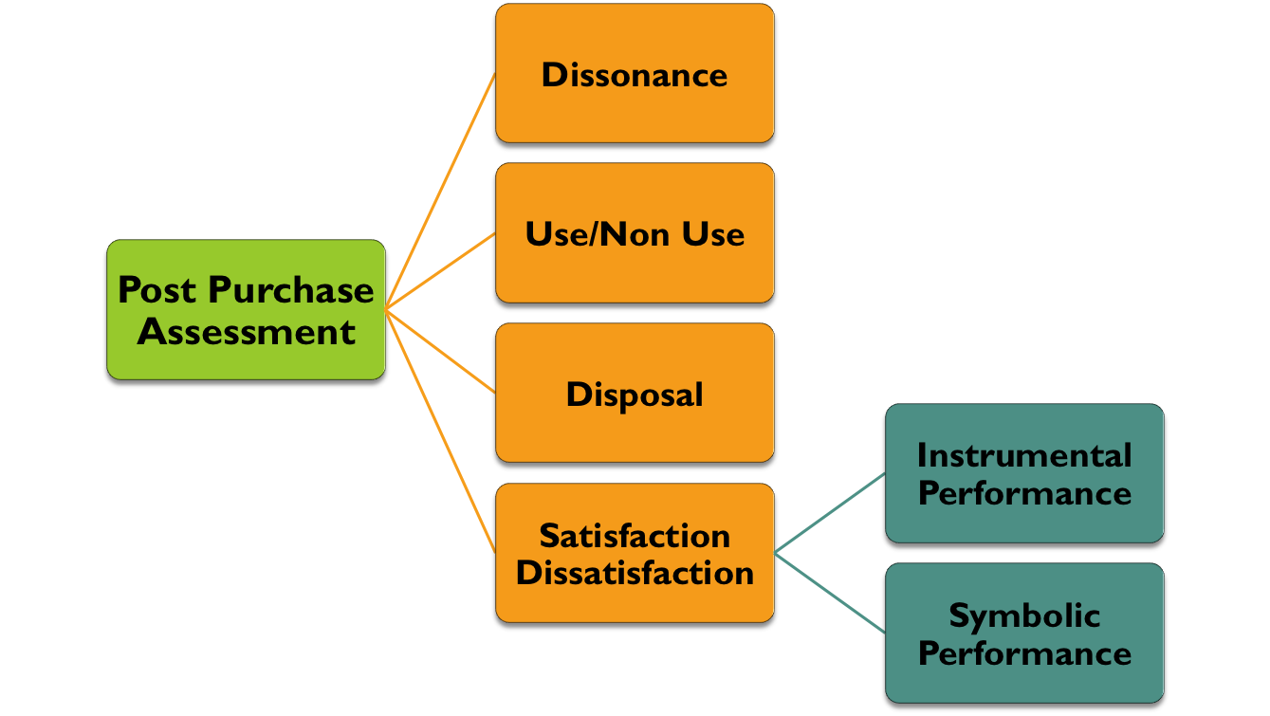
The Consumer Decision-Making Process: Post Purchase
Link to long alt text description
Notes:
Dissonance: High-involvement, large purchases often lead to a level of doubt or anxiety known as post-purchase dissonance. Most purchases occur with little or no dissonance. The likelihood of dissonance increases if one or more of the following purchase decision attributes are present: (1) a high degree of commitment that is not easily revoked; (2) a high degree of importance for the customer; (3) alternatives are rated equally and the purchase decision is not clear. Also, the individual’s own predisposition for anxiety can create additional dissonance.
Marketers are acutely interested in learning how customers use the product for several reasons. First, it is important the customer knows how to use the product correctly. Second, a satisfied customer means a greater likelihood of additional purchases.
Environmentally friendly products encourage proper use and disposal.
Satisfaction/dissatisfaction are evaluated on two dimensions. Most products are evaluated on two dimensions—instrumental performance and symbolic performance. Instrumental performance relates to the actual performance features of the product and answers the question: Did the product do what is what supposed to do? Symbolic performance refers to the image-building aspects of the product and answers the question: Did the product make me feel better about myself?

Slide 25
Differences between Business and Consumer Markets
Exhibit 6.9
 | B2B Market | Consumer Market
Relationship with Customers | Invest more in maintaining personal relationships | Impersonal; exist through electronic communication
Number and Size of Customers | Few but larger customers | More customers but buy in smaller, less frequent quantities
Geographic Concentration | Suppliers located strategically by the buyers | Could be anywhere in the world
Complexity of Buying Process | Complex process that can take a long time (years in some cases) and involve more people | Fewer people, often just one, directly involved in the purchase decision and the purchase decision is often based on personal and psychological benefits
Complexity of Supply Chain | Direct from supplier to manufacturer | Complex with products moving through the channel to reach the consumer
Demand for Products | Derived from consumer demand, fluctuates with changes to consumer demand and more inelastic (less price sensitive) | Consumer perceptions about their own needs mitigated by environmental factors and marketing stimuli

Slide 26
Differences between Business and Consumer Markets
Relationship with customers.
Number and size of customers.
Geographic concentration.
Complexity of buying process.
Complexity of the supply chain.
Notes:
Customers want direct communication with company representatives and prefer someone they know and trust. The individual most responsible for maintaining a relationship is the salesperson. At the same time, technology plays a critical role in connecting buyer and seller. Integrating IT systems that enhance sales response times, provide better customer service, and increase information flow is now an accepted element in a successful B2B customer relationship. Customers demand not only a personal relationship with their vendors but also an efficient one. Most companies now require vendor Internet connectivity to increase efficiency.
Business markets are characterized by fewer but larger customers. Losing even one large customer has striking implications for a company. Walmart is Procter & Gamble’s single biggest customer accounting for 14 percent of company sales (roughly equivalent to $10 billion). At its Arkansas office, P&G has a 300-member staff dedicated to one customer—Walmart.
Business markets tend to concentrate in certain locations. Historically, the automobile industry concentrated in the Midwest, particularly Detroit, and technology firms dominated Silicon Valley in California. As a result, their suppliers congregated nearby.
The B2B customer buying process, discussed later in the chapter, is more complex than the consumer purchase decision process. It takes longer and involves more people, making the seller’s job more challenging.
A supply chain is the synchronized movement of goods through the channel. It is far more integrated than ever before as companies seek to keep production costs low, provide maximum customer input and flexibility in the design of products, and create competitive advantage.

Slide 27
Demand for Products and Services Is Different in a Business Market
Product demand differs on three dimensions:
Derived demand: If consumers are buying finished products, producers need more inputs.
Fluctuating demand: The difference between consumer and business product demand.
Acceleration Effect
Inelastic demand: Producers by raw materials even if the price rises.
Notes:
Small changes in consumer demand can lead to considerable shifts in business product demand and is referred to as the acceleration effect. This makes forecasting the sale of consumer products important because making even a small mistake in estimating consumer demand can lead to significant errors in product production.
Derived Demand: Demand for B2B products originates from the demand for consumer products, or, put another way, demand for B2B products is derived demand. If consumers are not buying Ford cars and trucks, then there is no need for Ford to purchase Good- year tires. Therefore, it is important for Goodyear to understand the consumer market for automobiles for two reasons. First, knowing what consumers are looking for in a car is critical to designing tires for those car Second, knowing the consumer automobile market is essential to create a value proposition that speaks to Ford’s need to sell more cars and trucks to consumers.
Fluctuating Demand: The relationship between consumer demand and demand for business products presents a real challenge for business-to-business marketers. Small changes in consumer demand can lead to considerable shifts in business product demand and is referred to as the acceleration effect. This makes forecasting the sale of consumer products important because making even a small mistake in estimating consumer demand can lead to significant errors in product production.
Inelastic Demand: Business products experience fairly inelastic demand, meaning changes in demand are not significantly affected by changes in price.

Slide 28
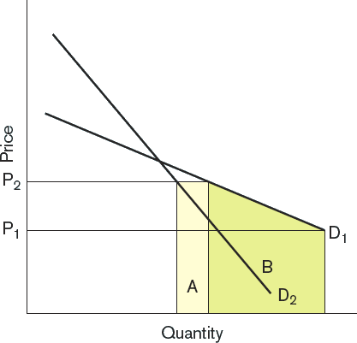
Examples of Elastic and Inelastic Demand
EXHIBIT 6.10
Link to long alt text description
Notes:
Exhibit 6.10 has two demand curves, D1 and D2. As price rises from P1 to P2 the demand changes. The more elastic demand curve is the one with the largest shaded area—B. Demand in business-to-business markets is generally more inelastic than consumer markets, which means changes in price have less effect on demand—the smaller shaded area A. This makes D2 an example of inelastic demand.

Slide 29
Factors Influencing Buying Situations
Factors influencing business buying decisions:
Nature of the purchase
Number of people involved in the decision
Understanding of the product being purchased
Time frame for the decision

Slide 30
Buying Situations
Straight rebuy
Modified rebuy
New purchase
Notes:
Straight rebuy Reorder products that are used on a consistent basis
Modified rebuy Familiar with product and supplier, but still seek additional information
New purchase First-time purchase of product or service

Slide 31
Buying Centers
A number of individuals with a stake in the purchase decision come together to form a buying center that manages the purchase decision process and ultimately makes the decision.

Slide 32
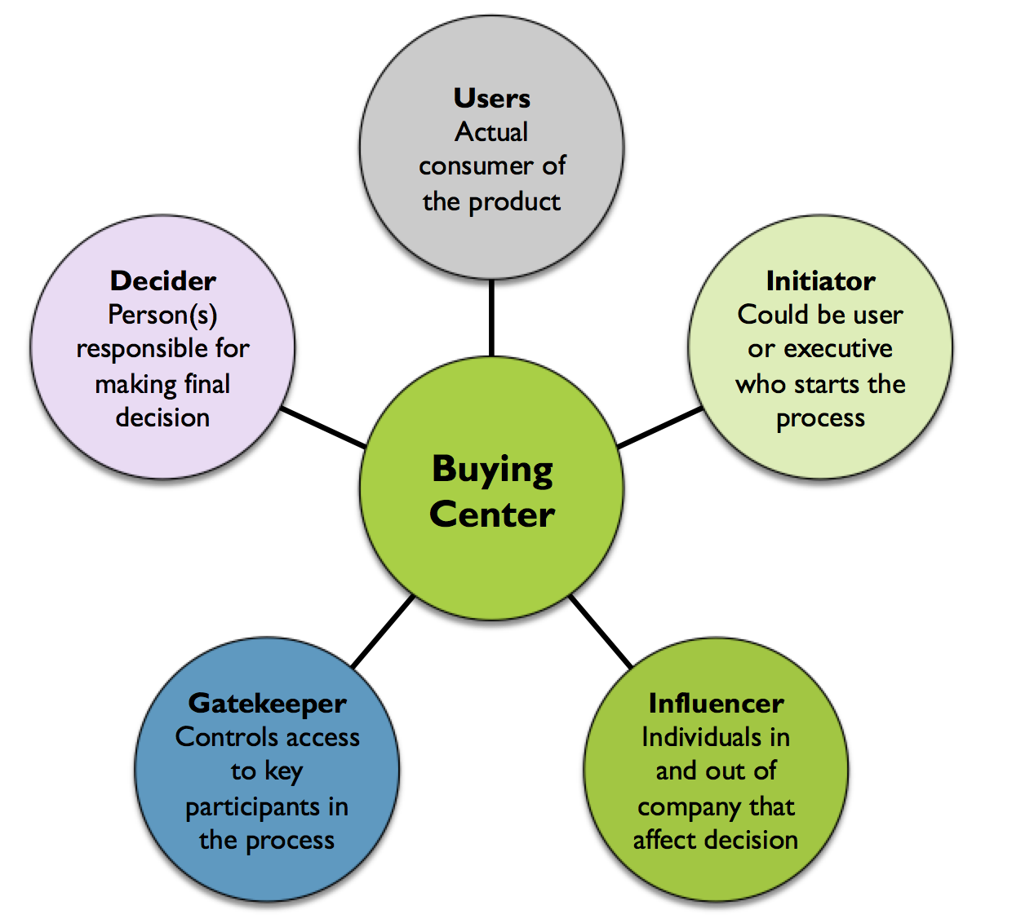
Buying Center Participants
Exhibit 6.11
Link to long alt text description

Slide 33
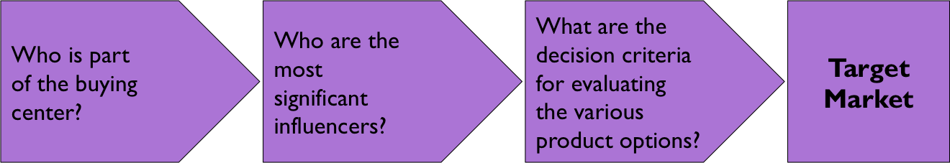
Marketing Challenges in Buying Centers
Exhibit 6.12
Link to long alt text description
Notes:
Buying centers present marketers with three distinct challenges, as presented in Exhibit 6.2. First, who is part of the buying center? Simply identifying the members of a buying center can be difficult and is made more challenging by gatekeepers whose role, in part, is to act as a buffer between buying center members and outside vendor representatives. The job of identifying membership in the buying center is made even more complex as participants come and go over time. Second, who are the most significant influencers in the buying center? This is critical in both preparing a sales presentation and following up. Targeting influencers is important in persuading the buying center to purchase the salesperson’s product. Finally, what are the decision criteria for evaluating the various product options? A very real concern for salespeople is making sure their products perform well on critical evaluation criteria; however, without a good understanding of evaluation criteria, it is not possible to assess the probability of the product’s success.

Slide 34
The Players in Business to Business Markets
The North American Industrial Classification System (NAICS): Manufacturers
Original equipment manufacturer (OEM) purchases
End-user purchases
Capital equipment
Materials, repairs, and operational (MRO)
Notes:
The SIC codes were updated in the 1990s and are now called the North American Industrial Classification System (NAICS). The system has been expanded to include businesses in Mexico and Canada. NAICS defines 20 major business sectors based on a six-digit hierarchical code. The first five digits are standardized across Mexico, Canada, and the United States while the sixth digit enables countries to adjust the code to fit the country’s own unique economic structure.
One of the largest groups of business customers is manufacturers, which consume two types of products. First, components used in the manufacturing process are called original equipment manufacturer (OEM) purchases. Companies selling OEM products work to convince the OEM customer their products offer the best value (price and quality) to the OEM’s customers.
There are two major types of end user purchases: capital equipment and materials, repairs, and operational (MRO) supplies and services. Capital equipment purchases involve significant investments and include major technology decisions (mainframe computers, ERP and CRM software packages) or critical equipment needed in the manufacturing process (large drill presses, robotic assembly systems). Since these purchases are considered a long- term investment, customers evaluate not only the purchase price but also other factors such as cost of ownership, reliability, and ease of upgrading. The cost and long-term commitment of these purchases mean senior management is often involved in the final decision. Frequently a buying center will evaluate options and make a recommendation to senior management. MRO supplies, on the other hand, are products used in everyday business operations and are typically not considered a significant expense. Purchasing agents or individuals close to the purchase decision, such as an office manager, are responsible for MRO purchases. Many of these purchases are straight rebuys; the individuals involved do not want to spend a lot of time making the purchase. Vendors in these industries are well aware that once they have a customer, the business is assured until the company does not perform up to customer expectations. Put another way, the business is theirs to lose.

Slide 35
The Players in Business to Business Markets
Resellers
Government
Institutions
Notes:
Companies that buy products and then resell them to other businesses or consumers are called resellers. Home Depot, for example, buys home products and then resells them to consumers, building contractors, and other professionals in the construction industry.
The single largest buyer of goods and services in the world is the U.S. government. Combined with state and local governments, the value of purchases is over $2 trillion.
Institutions such as nonprofits, hospitals, and other nongovernment organizations (NGOs) represent a large and important market that has some unique characteristics. First, profitability does not play as significant a role in many of these organizations; rather, the delivery of service to the targeted constituency is the primary objective. A second unique characteristic is a limited number of resources. Even the largest NGOs, including the Red Cross, do not have access to the capital and resources of most large for-profit organizations.

Slide 36
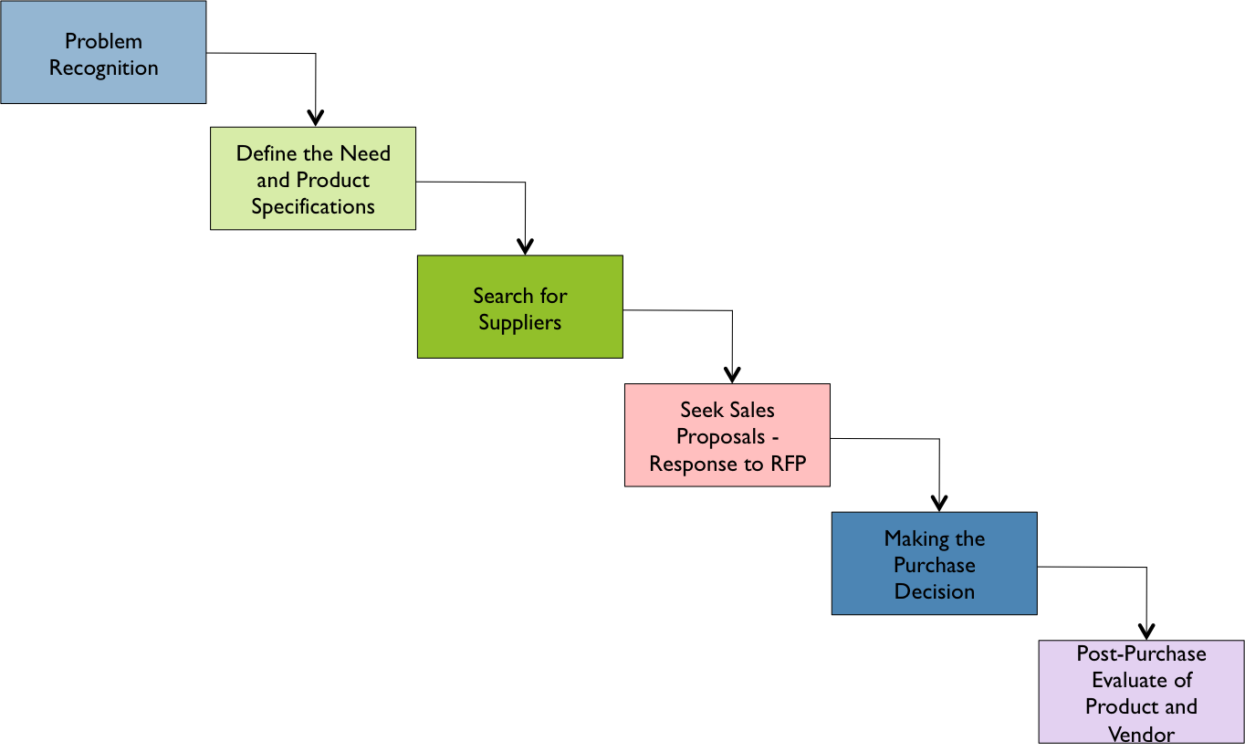
Model of Business Market Consumer Decision Process
EXHIBIT 6.14
Link to long alt text description

Slide 37
Problem Recognition
Define the need and product specifications.
Request for proposal (RFP)
Seek sales proposals in response to RFP.

Slide 38
Define the Need and Product Specifications
Product specifications should be clearly defined so that everyone inside and outside the firm understand.
Request for proposal (RFP) should achieve the details needed.
Salespeople should get involved early.
Notes:
The challenge for salespeople is to get involved in the purchase decision process as early as possible. If the salesperson, for example, has a strategic relationship with the customer, it may be possible to help define the product specifications. This is a real advantage because the vendor’s salespeople can work to create specifications that present their products in the most favorable way. Product specifications are often written in such a way as to limit the number of vendors. Companies realize that not knowing the product specifications puts them at a disadvantage over other vendors. It is still possible to win the order, but the job becomes more difficult.

Slide 39
Search for Suppliers
Two common methods:
Company creates a list of preferred or approved suppliers.
Search for and identify potential suppliers.
Internet
Thomas Global Register

Slide 40
Seek Sales Proposals in Response to the RFP
Request from a number of vendors.
Getting more information is good even when there is a preferred vendor
Additional proposals help in negotiating with the preferred vendor
RFP
Specifies how the vendors products meet the specs
Allows the proposal company to include additional information
Notes:
Companies frequently solicit proposals from a number of vendors for two reasons. First, even if there is a preferred vendor, getting more information about available options from other suppliers is a good idea. If it is an open vendor search, then the proposal becomes a valuable source of information as well as the primary evaluation tool. Second, getting additional proposals helps in negotiating with the preferred vendor. When a vendor is aware that other proposals are under consideration, that vendor works harder to meet the expectations of the customer.

Slide 41
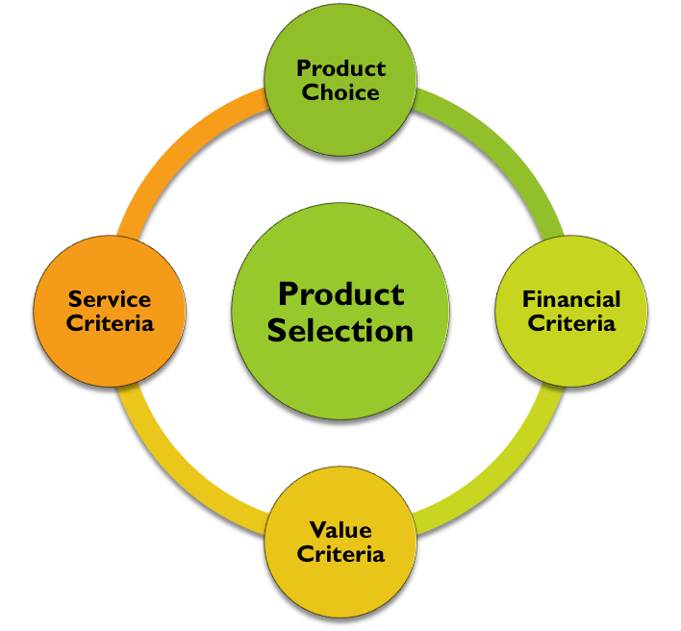
The Business Market Purchase Decision Process
Making the Purchase Decision
Notes:
Product Selection The first purchase decision is the product choice. In many cases the product decision is based on a single criterion. Single-criterion decisions usually fall into a straight rebuy or very limited modified rebuy situation and do not require a buying center to assist in the new purchase decision. Much of the time, however, no one product fits all the product specifications exactly. As a result, the final decision assesses the product against the product evaluation criteria and determines the optimal solution.
Financial criteria are a set of analyses and metrics grouped together to assess the cost of ownership. The actual purchase price is just one consideration in determining the real cost of a purchase. Maintenance and operating costs, repair charges, and supplies are all costs associated with ownership that can vary across product choices. These costs are then evaluated against the stated life of the product. This is important as some products with a higher initial price actually cost less over time because of the product’s longer life. Financial analysis also evaluates the time it takes to break even on the investment.
Value Criteria Value is the relationship between price and quality and it is a significant facet of the purchase decision. B2B buyers are aware that the lowest-cost product may not be the right product, especially in critical OEM equipment where failure can mean customer dissatisfaction or in strategic purchases such as a new IT system where failure can cause serious business disruption. On the other hand, it is costly to overengineer a product and purchase more than is needed for the situation.
Service Criteria Buyers are concerned with the service requirements of a product because servicing equipment costs a company in two ways. First, there is the direct cost of service, including labor and supplies. Second, there is the indirect cost of downtime when a system is out of service, which means the equipment is not being used for its intended purpose.

Slide 42
Supplier Choice
Decision makers know a bad decision can be made even if the product is right but the vendor is wrong.
Reliability is the vendor’s ability to meet the contract’s obligations.
Also, will the vendor go above and beyond what is specified in the contract?
Notes:
The most fundamental criterion in vendor selection is reliability, which is the vendor’s ability to meet contractual obligations.
The first, personal factors, refers to the needs, desires, and objectives of those involved in the purchase decision.- The primary organizational factor is risk tolerance.

Slide 43
Personal and Organizational Factors
Personal factors refers to the needs, desires, and objectives of those involved in the purchase decision.
What are the motivations of the key players?
Promotion, raise, impress management?
The key organizational factor is risk tolerance.
Notes:
The primary organizational factor is risk tolerance. Individuals and companies all have a certain tolerance for risk. Their product decisions will be influenced by their aversion to or acceptance of risk. Consider the IT manager looking to purchase a new network for his company. Two suppliers have submitted proposals that meet the product specification. One is a local vendor with an excellent reputation. This vendor has quoted a lower price and guaranteed better service. The other is Cisco Systems, the world leader in network equipment and software. The manager for the company with a low risk tolerance will probably choose Cisco Systems. It represents the “safe” choice. His superiors would never question purchasing from the market leader. If the same individual works for a risk-tolerant organization, the decision might be to go with the vendor offering better price and service.

Slide 44
Post-purchase Evaluation of Product and Supplier
Assess product performance.
Consider the level of support provided by seller.
Expect follow up after sale.

Slide 45
The Role of Technology in Business Markets
Electronic data interchange (EDI)
E-Procurement
Industry Purchasing Sites
Business Function Sites
Extranet to Major Suppliers
Company Buying Sites
Notes:
Industry purchasing sites: Industries have formed websites to streamline and standardize the e-procurement process. Steel, chemicals, paper, and automobile manufacturers have created integrated websites to assist their own purchasing departments in online purchasing and supplier selection.
Business function sites: Certain business functions have websites to standardize purchasing. For example, individual utilities used to negotiate by phone to buy and sell electricity with each other; however, today the purchase of electricity by utility companies is now done over a website dedicated to energy management.
Extranet to major suppliers: Many companies have set up direct links to approved suppliers to make the purchase easier and move it closer to front-line decision makers. Office Depot, for example, has a number of direct relationships using EDI with thousands of companies.
Company buying sites: Many large companies have created their own websites to assist vendors. RFPs and other relevant supplier information as well as some contact information are accessible for review.

Slide 46
Alt Text Appendix
All long alt text descriptions are included in this appendix.

Slide 47
Model of the Consumer Decision Process
At the center of the consumer decision process are internal forces and external forces. Internal forces include personal characteristics and psychological attributes. External forces include cultural, situational, and social factors. The relationship between these is marked with a two-way arrow. Surrounding these internal and external forces are the steps in the consumer decision process. They unfold in this order: 1) problem recognition, 2) search for information, 3) evaluation of alternative solution, 4) product choice decision, and 5) post-purchase assessment. The cycle then repeats. Above this are two boxes. One names the marketing activities that affect the consumer decision process. They are value proposition, distribution, and marketing communications. The other box lists environmental forces that affect the consumer decision process. These include economic, technological, and political factors. Arrows point from the marketing activities and environmental forces boxes to the consumer decision process.

Slide 48
Consumer Decision-Making Process
There are five steps in the consumer decision-making process. The first step is problem recognition. The second step is the search for information. The third step is the evaluation of alternatives. The fourth step is product choice decision. The fifth, and last, step is the post-purchase decision.

Slide 49
Consumer Decision-Making Process: Search for Information
The search for information branches into three types of searches. They are the minimal information search, the limited information search, and the extensive information search.

Slide 50
Consumer Decision-Making Process: Information Sources
The search for information is directly connected to information sources. Information sources branch off into two categories. The first is an internal information search. The second is exploring external information sources.

Slide 51
Consumer Decision-Making Process: Set of Alternatives
The search for information is directly connected to defining the set of alternatives. Defining the set of alternatives branches off into three categories. They are the complete set, the awareness set, and the consideration (evoked) set.

Slide 52
Consumer Decision-Making Process: Evaluation of Alternatives
The evaluation of alternatives branches into three types of choices. They are emotional choices, attitude-based choices, and attribute-based choices.

Slide 53
Consumer Decision-Making Process: Product Choice Influences
The product choice decision branches into four types of influences. The first is physical surroundings. The second is social circumstances. The third is time. The fourth is state of mind.

Slide 54
Consumer Decision-Making Process: Post Purchase
Post-purchase assessment branches into four categories. They are dissonance, use/non-use, disposal, and satisfaction/dissatisfaction. The satisfaction/dissatisfaction category branches into two subcategories. The subcategories are instrumental performance and symbolic performance.

Slide 55
Examples of Elastic and Inelastic Demand
Two demand curves named D1 and D2 both show that quantity increases as price declines. Two prices, P1 and P2, are represented by horizontal lines. The demand curves intersect with these two prices. Demand curves D1 and D2 intersect with one another because D1 is less steep than demand curve D2. The two areas underneath D1 and D2 are shaded. The area under D1 is labeled B. It the largest, meaning it is more elastic. To the right of area B is the area under D2, which is labeled A. It is about four to five times smaller than area B.

Slide 56
Buying Center Participants
In the center of the figure is the buying center. In spokes around the center, each of the five buying center participants is described. The first is users, who are actual consumers of the product. The next are initiators, who could be users or executives who start the buying process. Then, are the influencers, who are individuals in and out of a company who affect the decision. Next are the gatekeepers, who control access to key participants in the process. Finally, are deciders, who are the people responsible for making the final decision.

Slide 57
Marketing Challenges in Buying Centers
Three questions are depicted in a row of arrows that point to the target market. The first of these questions is: Who is part of the buying center? The second question is: Who are the most significant influences? The third is: What are the decision criteria for evaluating the various products. This third question points directly to a square that says target market.

Slide 58
Model of Business Market Consumer Decision Process
The first step in the business market consumer decision process if problem recognition. The next step is defining the need and product specifications. After that the search for suppliers begins. The next step is seeking sales proposals and responses to RFPs. Then the purchase decision is made. Finally, the post-purchase evaluation of the product and vendor takes place.

